Slide 1
Microeconomics for Business
Chapter 5 – Market Equilibrium
Government Policies
Price Ceiling

Slide 2

People need food, so government decrees that a loaf of bread cannot cost more than $.25 a pound (a loaf of bread weighs about a pound).
Would you support this policy?

Slide 3
Will there be more or less bread produced?

Slide 4

If there is less bread produced than people want, how do we decide who gets it?
Notes:
The next 3 slides discuss possible answers to this question.

Slide 5
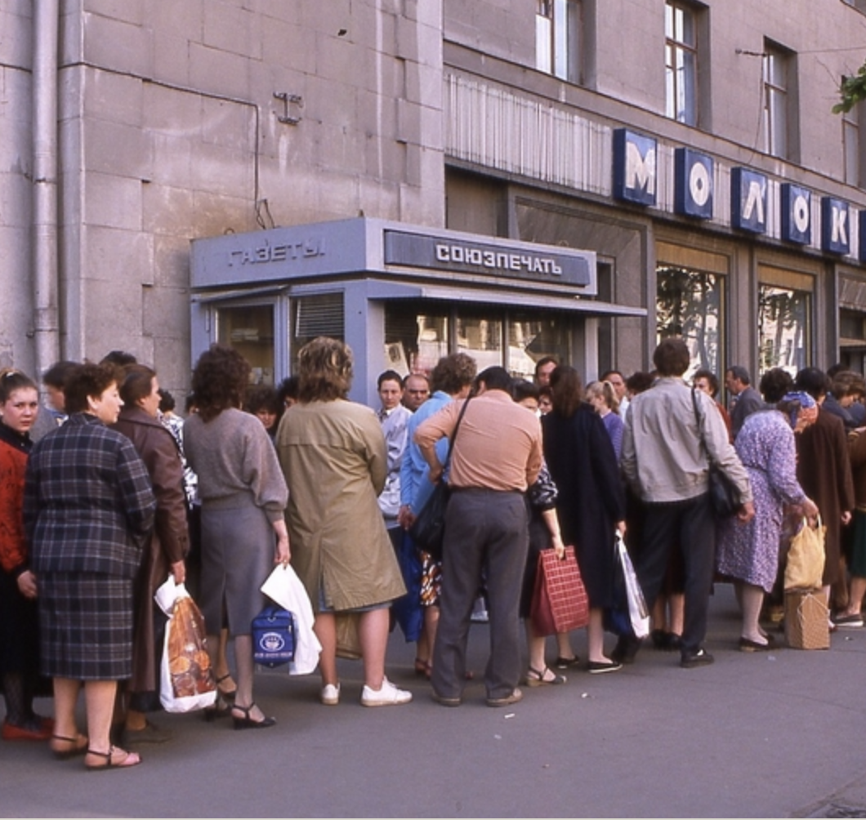
If there is less bread produced than people want, how do we decide who gets it?
First come, first serve?
Downsides: Long lines, Fights
“The accepted norm is that the Soviet woman daily spends two hours in line, seven days a week…I have known of people standing in line… three and a half hours to buy three large heads of cabbage only to find the cabbages were gone as they approached the front of the line, 18 hours to sign up to purchase a rug at some later date, all through a freezing December night to register on a list for buying a car, and then waiting 18 months for actual delivery”
Notes:
Source: Smith, Hedrick. The Russians. Vol. 29764. Crown, 1976.

Slide 6

If there is less bread produced than people want, how do we decide who gets it?
An official decides?
Downsides:
Cronyism
Costly decision process
Filling out forms

Slide 7
With this policy,
do you think the quality/variety of bread increase or decrease?
Notes:
The quality will likely decrease. Ask students what incentives producers will have to increase quality/variety if they can’t increase prices.

Slide 8
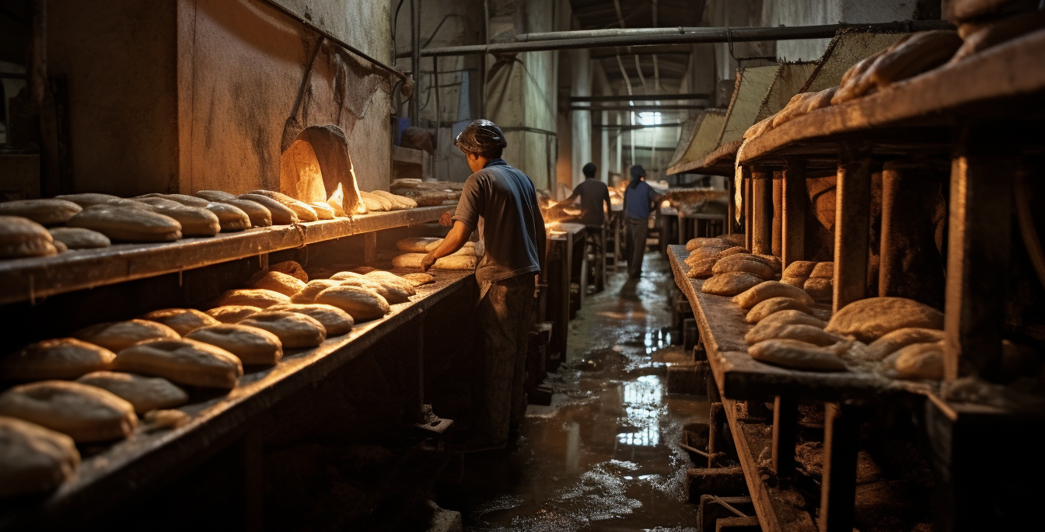
And will an underground bread market develop?
Notes:
If people are willing to pay $5 for a loaf and the government says you can’t charge $2, then people may sell bread under the table.

Slide 9
Price Ceiling Possible Results
Shortages
Long Lines
Rationing
Underground Markets
Lowered Quality

Slide 10


Price Controls Unintended Consequences
Why were Soviet cars in the 1970s and 80s of worse quality and had less variety than American and Japanese cars?

Slide 11

There was a price ceiling on Soviet cars so manufacturers had little incentive to increase quality and variety of the cars.

Slide 12
Graphing a Price Ceiling
PRICE
BREAD MARKET
S
P₀
D
Q₀
QUANTITY

Slide 13
PRICE
BREAD MARKET
S
Price Ceilings above the equilibrium price will not matter
P Ceiling
P₀
D
Q₀
QUANTITY

Slide 14
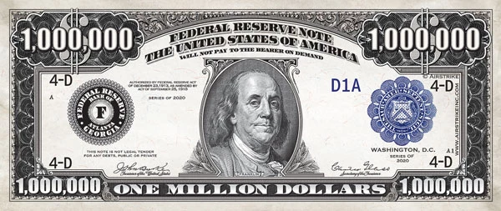
For Example:
If the government says bread cannot cost more than
1 million dollars a loaf, the market will not be affected.

Slide 15
PRICE
BREAD MARKET
S
Price Ceilings below the equilibrium price will alter the market
P₀
P Ceiling
D
Q₀
QUANTITY

Slide 16
PRICE
BREAD MARKET
S
The market price should be P₀
P₀
P Ceiling
D
Q₀
QUANTITY

Slide 17
PRICE
BREAD MARKET
S
The market price should be P₀, but the market is stuck at the price ceiling.
P₀
P Ceiling
D
Q₀
QUANTITY

Slide 18
PRICE
BREAD MARKET
S
At this lower price, buyers want to buy more than they did before.
They would like to buy Q_{D} amount of bread.
P₀
P Ceiling
D
Q₀
Q_{D}
QUANTITY

Slide 19
PRICE
BREAD MARKET
S
However, at this lower price, sellers do not want to produce as much as they did before.
They would like to make only Q_{s} amount of bread.
P₀
P Ceiling
D
Q_{S}
Q₀
Q_{D}
QUANTITY

Slide 20

PRICE
BREAD MARKET
S
Since buyers want more bread than sellers are willing to produce, a shortage develops.
P Ceiling
Shortage
D
Q_{S}
Q_{D}
QUANTITY

Slide 21
PRICE
BREAD MARKET
S
For instance, if the market price of bread was $2. The people wanted 100 loaves of bread at that price.
$2
D
100
QUANTITY

Slide 22
PRICE
BREAD MARKET
S
If the market price of bread was $2, and the government capped the price at $0.75.
200 loaves is now demanded, but producers only want to make 50 loaves.
$2
$0.75
D
50
200
QUANTITY

Slide 23
PRICE
BREAD MARKET
S
So there are now 150 people that want to buy loaves at a price of $0.75, that cannot get them.
$2
$0.75
D
Shortage (150)
50
200
QUANTITY

Slide 24
Shortages and Rationing
With a shortage, sellers must ration the goods among buyers.
Some rationing mechanisms: (1) Long lines
(2) Discrimination according to sellers’ biases
These mechanisms are often unfair and inefficient: the goods do not necessarily go to the buyers who value them most highly.
In contrast, when prices are not controlled,
the rationing mechanism is efficient (the goods
go to the buyers that value them most highly)
and impersonal (and thus fair).
Notes:
‹#›
The last two bullets discuss “efficiency” in the context of rationing goods to those buyers who value them most highly. This concept will be explored further in the following chapter.

Slide 25
Welfare Effects of Price Ceilings
PRICE
BREAD MARKET
S
Total Surplus before the price ceiling is consumer surplus (in green) plus producer surplus (in red)
Consumer Surplus
P₀
Producer Surplus
D
Q₀
QUANTITY

Slide 26
PRICE
BREAD MARKET
S
After the price ceiling, only Q_{s} are sold as producers will not want to produce more than that. Consumer surplus is the area below the demand curve to the lower price, extending to the new quantity supplied. Producer surplus is reduced to the area below the new lower price and above the supply curve.
Consumer Surplus
P Ceiling
Producer Surplus
D
Q_{S}
QUANTITY

Slide 27
PRICE
BREAD MARKET
S
The deadweight loss is the difference between the total surplus before the price ceiling and the total surplus after.
Deadweight loss
Consumer Surplus
↙
P Ceiling
D
Q_{S}
QUANTITY

Slide 28
PRICE
BREAD MARKET
S
Note: We have assumed that the consumers with the highest willingness to pay get the good, in reality this probably isn’t the case, so the actual consumer surplus is lower. Further, the good will likely diminish in quality over time, lowering consumer surplus even more.
Consumer Surplus
P Ceiling
Producer Surplus
D
Q_{S}
QUANTITY

Slide 29
Price Ceiling: Caveat
In a later chapter we will show how a price ceiling can benefit all consumers when the market is not competitive.

Slide 30
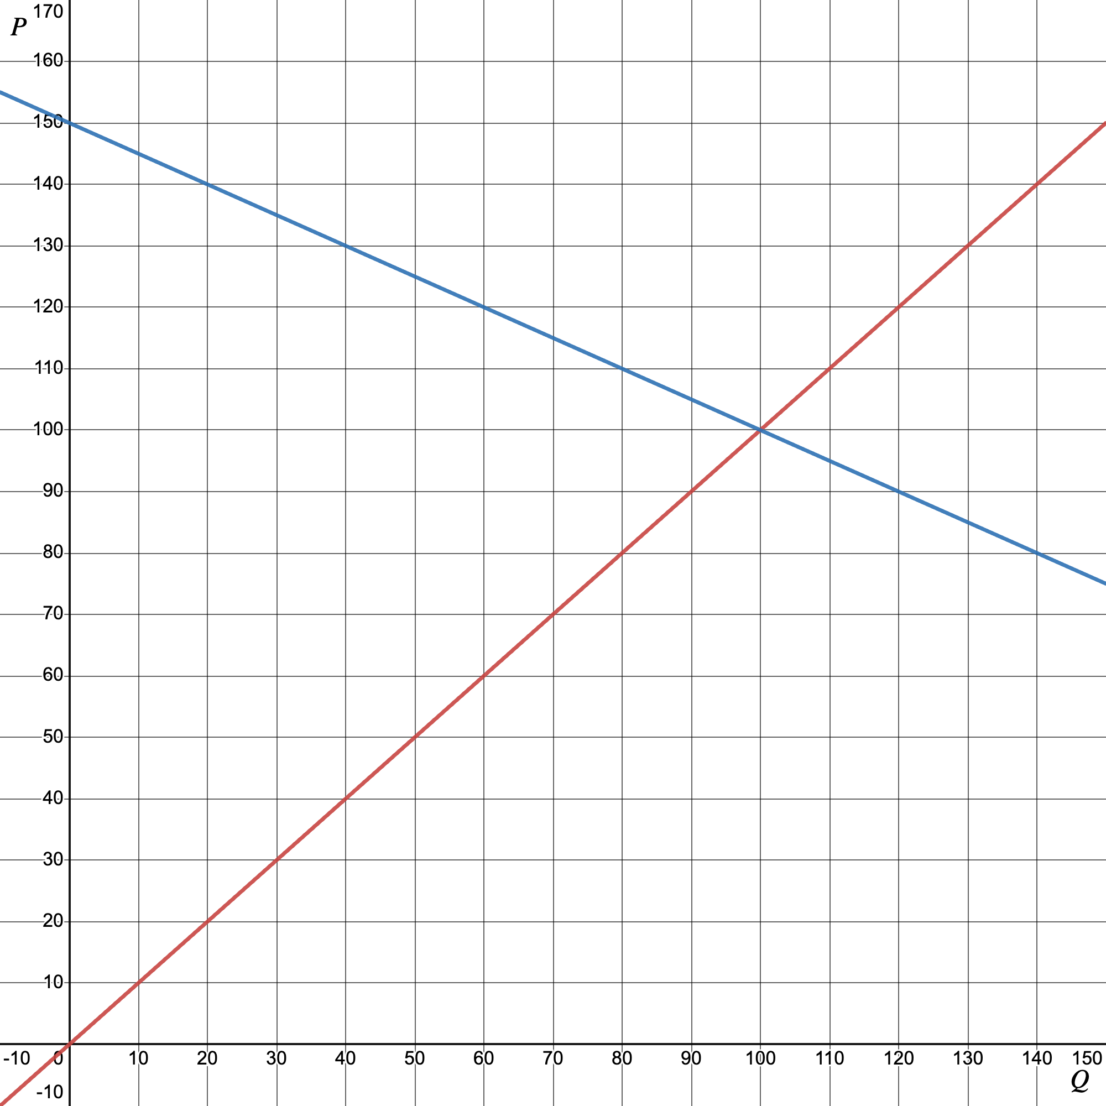
Question
What is the effect of a $90
Price ceiling?
What is the deadweight loss of such a policy?
Would producers favor this policy?
Would consumers?

Slide 31
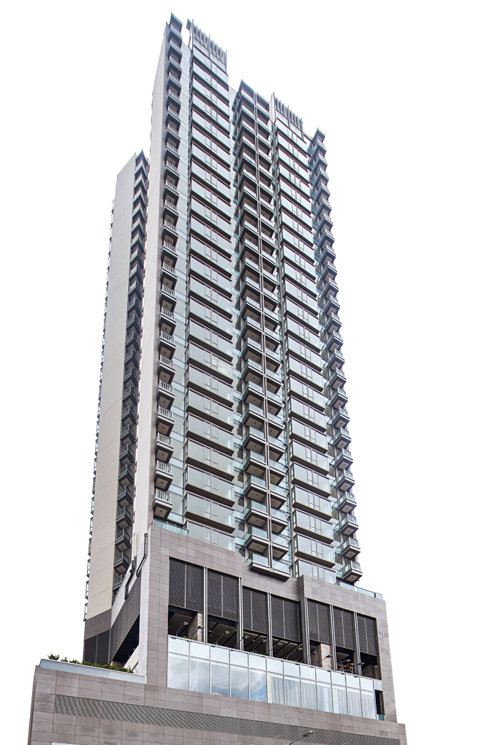
Rent Control is a popular price ceiling.
What will be the direct effect?

Slide 32
PRICE
APARTMENT MARKET
S
Price
Ceiling
Shortage
D
Q_{S}
Q_{D}
QUANTITY

Slide 33
Try to come up with as many unintended consequences as possible to the rent control policy.

Slide 34
Consequences of Rent Control
Limits new housing supply | Many developers decide to not build new apartments now that there is a limit on prices.¹
Lowers existing supply | Many landlords will turn their units into condos and sell them.²
Increase housing prices (in surrounding areas) | Shortages in housing push people to surrounding towns and that increases prices there.³
Existing units fall into disrepair (lower quality) | Property owners know they can easily find tenants so they are less responsive to repairs and general upkeep of units.⁴
Reduces people’s ability to move to opportunity | Once a tenant has secured a rent-controlled apartment, she may not choose to move even if her housing needs change or new opportunity in a different city arises.⁵
Increase government costs | Administering the program costs money.⁶
Increases hidden fees | Bribes and other hidden fees may be used by landlords when many applicants vie for a rent control apartment.⁷
Notes:
Sources. 1: https://www.naahq.org/examining-unintended-consequences-rent-control-policies-cities-across-america
2: Friedman, Milton, and George Stigler. "Roofs or ceilings." The Current Housing Problems, Popular Essays on Current Problems 1.2 (1946).
Diamond, Rebecca, Tim McQuade, and Franklin Qian. "The effects of rent control expansion on tenants, landlords, and inequality: Evidence from San Francisco." American Economic Review 109.9 (2019): 3365-3394.
3 Diamond, Rebecca, Tim McQuade, and Franklin Qian. "The effects of rent control expansion on tenants, landlords, and inequality: Evidence from San Francisco." American Economic Review 109.9 (2019): 3365-3394.
4 Downs, Anthony, “Residential Rent Controls,” Washington, DC: Urban Land Institute, 1988
Sims, David P. "Out of control: What can we learn from the end of Massachusetts rent control?." Journal of Urban Economics 61.1 (2007): 129-151.
5 Glaeser, Edward L and Erzo FP Luttmer, “The Misallocation of Housing under Rent Control,” The American Economic Review, 2003, 93 (4), 1027–1046,
Sims, David P. “Rent Control Rationing and Community Composition: Evidence from Massachusetts,” The BE Journal of Economic Analysis & Policy, 2011, 11 (1).,
Bulow, Jeremy, and Paul Klemperer. "Regulated prices, rent seeking, and consumer surplus." Journal of Political Economy 120.1 (2012): 160-186.
Diamond, Diamond, Rebecca, Tim McQuade, and Franklin Qian. "The effects of rent control expansion on tenants, landlords, and inequality: Evidence from San Francisco." American Economic Review 109.9 (2019): 3365-3394.
6 Downs, Anthony, “Residential Rent Controls,” Washington, DC: Urban Land Institute, 1988 Sims, David P. "Out of control: What can we learn from the end of Massachusetts rent control?." Journal of Urban Economics 61.1 (2007): 129-151.
7 https://www.city-journal.org/article/the-return-of-key-money

Slide 35

Rent Control (summary)
May help existing tenants in the short run (increase consumer surplus)
Long run consequences are negative
  Higher prices in surrounding areas
  Less rental units
  More low quality units
  Hidden fees

Slide 36
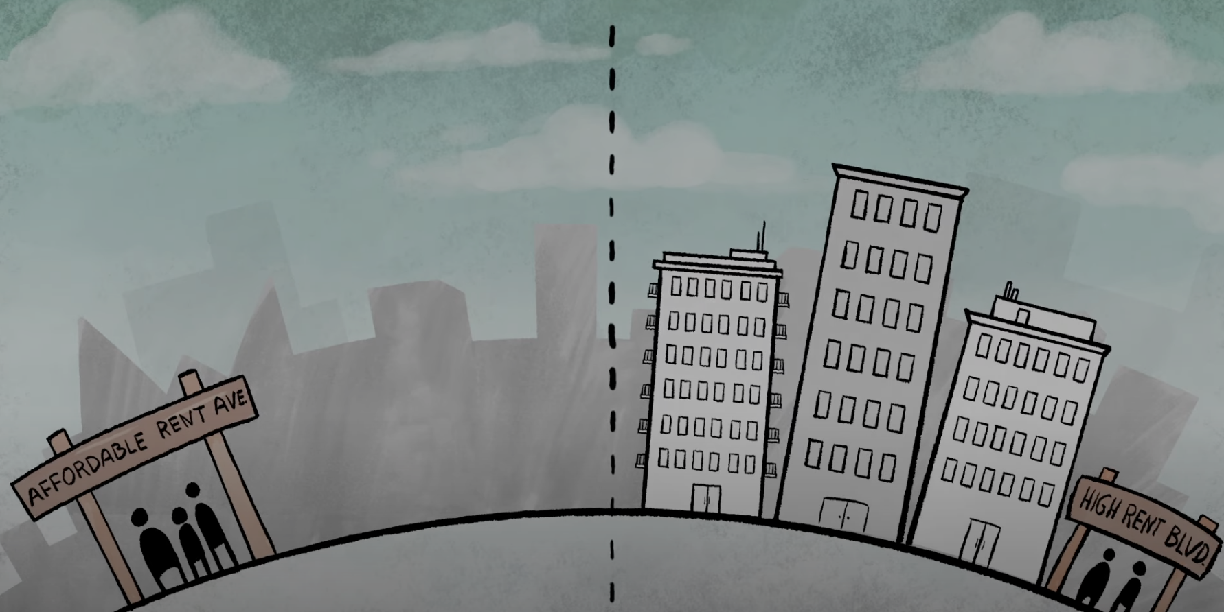

Rent Control (summary)
“The Americans couldn’t destroy Hanoi, but we have destroyed our city by very low rents. We realized it was stupid and that we must change policy.”
- Nguyen Thach on Rent Control
“In many cases rent control appears to be the most efficient ​​technique presently known to destroy a city—except for bombing.”
- Swedish economist Assar Lindbeck
“No Vacancy:
The Consequences of Rent Control”
https://www.youtube.com/watch?v=dBragREvqXg

Slide 37
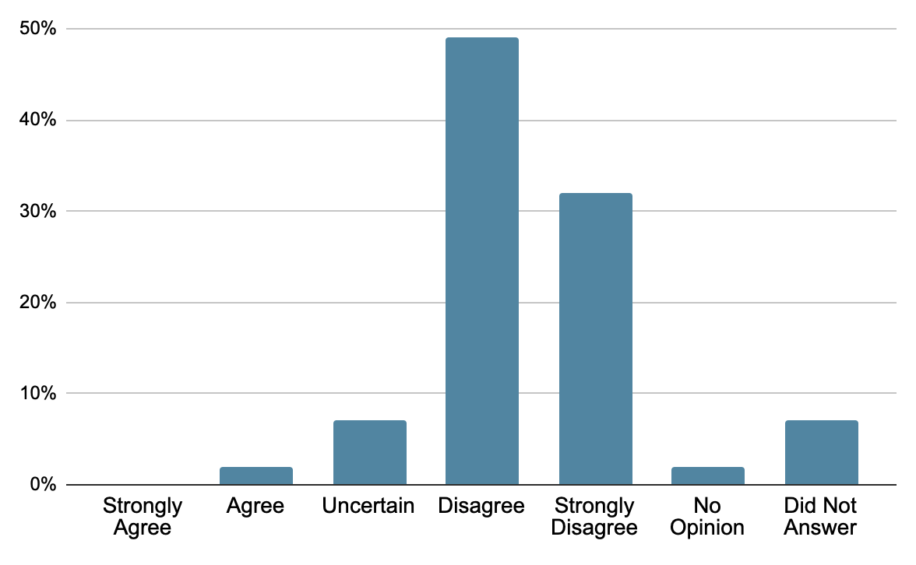
And yet the policy remains popular, except among economists:
81% of economists disagree or strongly disagree
Survey question:
“Local ordinances that limit rent increases for some rental housing units, such as in New York and San Francisco, have had a positive impact over the past three decades on the amount and quality of broadly affordable rental housing in cities that have used them.”
Survey of Economists by Kent A. Clark Center for Global Markets (2024)

Slide 38
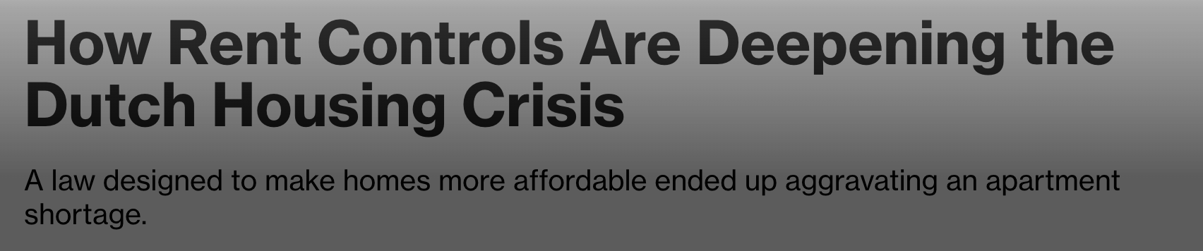
And yet, they never go away and no one ever learns (headline from 2024) —

Slide 39

https://learn.mru.org/interactives/price-ceilings?back=interactives

Slide 40
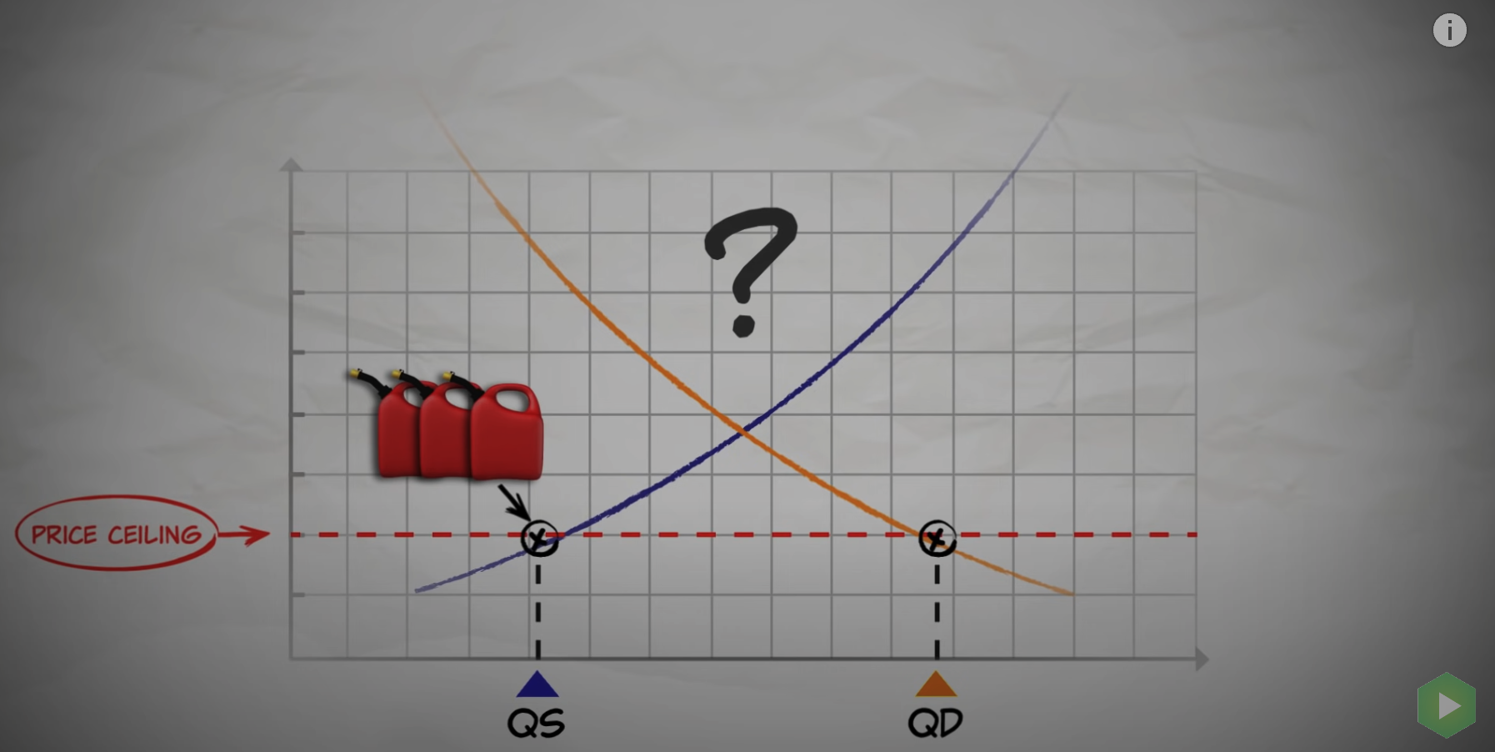
“Price Ceilings: From Helping Consumers to dead baby chickens”
https://www.youtube.com/watch?v=sq1zIj8s8R0

Slide 41
Price Floors

Slide 42

Spangler Candy planned to move its Candy Cane factory from Ohio to Mexico. The CEO said if the government did one thing he could keep the factory in Ohio.
What is the one thing?

Slide 43

CEO:
“And I said, I just need one thing. People get excited. And then I ask them to guess what's the one thing that you need. And people guess, you know, all kinds of things - lower tax rates. And how about workers comp reform? And let's get rid of OSHA. And let's repeal the Food Safety Modernization Act or pass a right-to-work law. Or let's get some government development money. These are some of the things they guessed amongst other things. And I said, no, it's not any of those. In fact, it's not all of those put together. If I paid zero taxes and got all those other things, which some of them don't even matter to us, it's not as important as the one thing that I need. And people are still guessing what it is. And I said, let us buy sugar on the free market. And there's a silence and then this kind of collective huh. Why can't you do that? And then I say, it's a story, and I'm about to tell it to you.”
Notes:
https://www.npr.org/transcripts/594317012

Slide 44

Price Floors
Price Floors are a minimum price. It is when the government makes it so the price cannot go below a certain amount.

Slide 45
PRICE
BREAD MARKET
S
Price Floors below the equilibrium price will not matter
P₀
P Floor
D
Q₀
QUANTITY

Slide 46
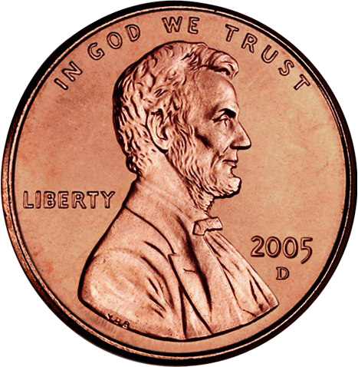
For Example:
If the government says the price of bread cannot go below a cent, the market will not be affected.

Slide 47
PRICE
BREAD MARKET
S
Price Floors above the equilibrium price will alter the market
P Floor
P₀
D
Q₀
QUANTITY

Slide 48
PRICE
BREAD MARKET
S
P Floor
The market price should be P₀
P₀
D
Q₀
QUANTITY

Slide 49
PRICE
BREAD MARKET
S
The market price should be P₀, but the market is stuck at the price floor.
P Floor
P₀
D
Q₀
QUANTITY

Slide 50
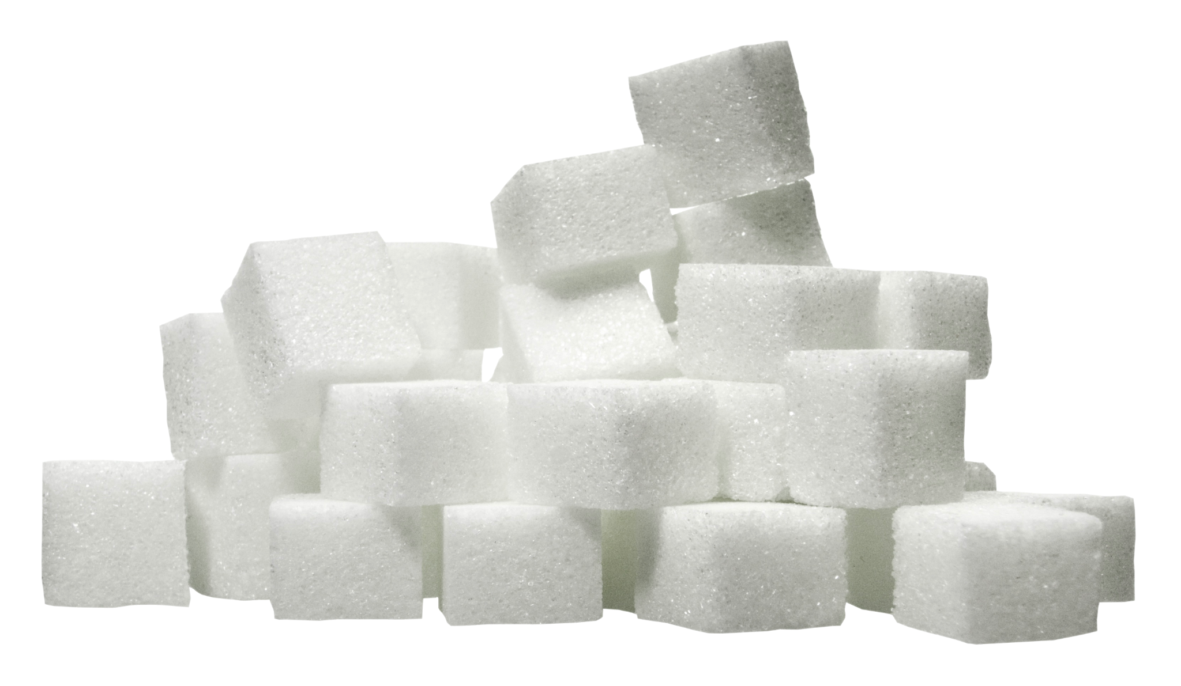
We have a price floor in the U.S. on Sugar.

Slide 51
PRICE
SUGAR MARKET
S
$0.23/lb
The government mandates the price/lb of sugar cannot be below 23 cents
P₀
D
Q₀
QUANTITY

Slide 52
Who loses because of the price floor?

Slide 53
PRICE
SUGAR MARKET
S
$0.23/lb
Consumers! Who have to pay higher prices and therefore their quantity demanded decreases
$0.08/lb
D
Q_{D}
QUANTITY

Slide 54
PRICE
SUGAR MARKET
S
$0.23/lb
Producers will want to produce (Q_{S}) more at the price floor
D
Q_{Dç}
Q_{S}
QUANTITY

Slide 55
PRICE
SUGAR MARKET
S
$0.23/lb
So there may be a surplus in the market as the quantity supplied exceeds the quantity demanded
Surplus
D
Q_{D}
Q_{S}
QUANTITY

Slide 56

Surplus
In practice, producers may not overproduce and simply produce enough to meet demand.
Or producers may try to lobby government to buy the surplus from them.
In the 1970s, the government had put a guaranteed price (price floor) for milk and agreed to buy up the surplus, this is what happened:

Slide 57

“Big Government Cheese” Video (NPR)
https://www.youtube.com/watch?v=LeZrnbKNkuw&t=109s

Slide 58
Welfare Effects of Price Floors
PRICE
SUGAR MARKET
S
Total Surplus before the price floor is consumer surplus (in green) plus producer surplus (in red)
Consumer Surplus
P₀
Producer Surplus
D
Q₀
QUANTITY

Slide 59
Back to sugar market, who gains because of the price floor?

Slide 60
Back to sugar market, who gains because of the price floor?

Slide 61
PRICE
SUGAR MARKET
S
After the price floor, only Q_{D} are sold as consumers will not want more than that (assuming the government doesn’t buy the surplus). Consumer surplus is reduced.
Consumer Surplus
P Floor
Producer Surplus
D
Q_{D}
QUANTITY

Slide 62
PRICE
SUGAR MARKET
S
If the higher prices offset the lower quantity sold, then producer surplus will increase.
Consumer Surplus
P Floor
Producer Surplus
D
Q_{D}
QUANTITY

Slide 63
PRICE
SUGAR MARKET
S
The deadweight loss is the difference between the total surplus before the price floor and the total surplus after.
P Floor
Consumer Surplus
↙
Deadweight
loss
D
Q_{D}
QUANTITY

Slide 64

https://learn.mru.org/interactives/price-floors?back=interactives

Slide 65
Question
What is the effect of a $110
Price floor?
What is the deadweight loss of such a policy?
Would producers favor this policy?
Would consumers?

Slide 66
Why do price floors stay?
Notes:
https://onlinelibrary.wiley.com/doi/10.1111/j.1467-923X.2005.00659.x/abstract;jsessionid=2148588495E5DD05B33997B19830FF0C.f04t04?userIsAuthenticated=false&deniedAccessCustomisedMessage=

Slide 67
Diffuse Costs and Concentrated Benefits
When there is a small group will gain a lot from a policy, they are incentivized to be highly organized and lobby for the policy.
Often the gains will not outweigh the costs.
But if the costs are distributed among a large group of people and are small at the individual level, it will be hard for that group to organize and stop it.

Slide 68




Diffuse Costs and Concentrated Benefits
Back to the sugar price floor:
In sugar, a small group of farmers gain a lot from the price floor.
A lot of consumers lose a little each in the form of higher prices.

Slide 69
Diffuse Costs/Concentrated Benefits and Policy Persistence (Summary)
Strong Incentive for Beneficiaries: These benefits are significant to them, motivating continued aggressive lobbying and political support.
Weak Incentive for the General Public: The costs, although potentially large in total, are diffused among a vast population. Each individual's share is small, making it less likely that they will notice or actively oppose the policy. This lack of strong public resistance allows inefficient policies to continue.
Information Asymmetry: The general public may not be fully aware of the policy's impact or the extent of the costs they bear.
Political Leverage: Beneficiaries, being a smaller and more cohesive group, can exert considerable political influence. They often have the resources and motivation to engage in effective lobbying, campaign contributions, and other forms of political persuasion.
Legislative Inertia: Once in place, policies can be difficult to reverse due to legislative inertia. Changing or repealing a policy often requires significant political will and effort, which may not be forthcoming if the public is disengaged.

Slide 70



Price Controls Unintended Consequences
Why was air travel so nice in the 1970s?
Notes:
https://www.aei.org/carpe-diem/even-with-fees-the-miracle-of-flight-remains-a-real-bargain-cost-of-air-travel-per-mile-has-fallen-by-50-since-1980/

Slide 71

Price Controls Unintended Consequences
There was a price floor on airline tickets, so airlines couldn’t lower their prices. So instead of competing for customers by lowering prices (which was illegal), they competed by offering more perks.
Looks nice, but would you pay double for it? (Prices were about 2x current prices in the 1970s)
Notes:
https://www.aei.org/carpe-diem/even-with-fees-the-miracle-of-flight-remains-a-real-bargain-cost-of-air-travel-per-mile-has-fallen-by-50-since-1980/

